Slide 1
Week 5 – Nunit details
QA Automation Course

Slide 2
Dido Demo – how to run Nunit tests within Visual studio

Slide 3
Selectors game

Slide 4
Homework review

Slide 5
Selectors how to
Try to locate element within LOGICAL modules
Use max 2-3 steps to locate an element
In selectors there should be words that has HUMAN meaning like: header, footer, left column, Search module, Some other module; instead of “content-wrap content-fluid” “bg-gray-light”
Try to locate the element in human words first, like: “this is the last green button in the search module” or “this is the hidden SEO text”
Always try to find what makes the element unique

Slide 6
What we’ll do today
How to run Nunit tests within Visual studio
Nunit Attributes
Nunit Assertions and Warnings
WebDriver.Url WebDriver.Title

Slide 7
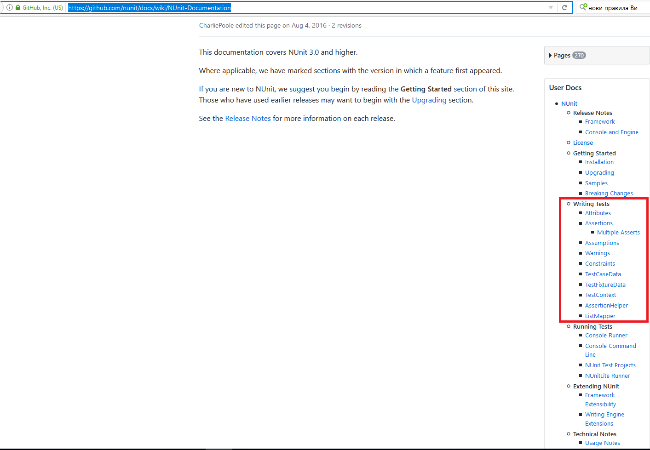
Nunit
Nunit home https://github.com/nunit/docs/wiki
Nunit documentation https://github.com/nunit/docs/wiki/NUnit-Documentation

Slide 8
Nunit Attributes (1)
[Test] [TestFixture]
[Test] – marks method as test
[TestFixture] – marks class as a test suite
[SetUp] [TearDown]
Executed before/after EACH test in the current Fixture
[OneTimeSetUp] [OneTimeTearDown]
Executed before/after ALL tests in the current Fixture
Demo Simple SettingUpAndTearingDown

Slide 9
Nunit Attributes (2)
[Author]
[Test]
[Author("Joe Developer")]
public void Test1() { /* ... */ }
[Category]
[Test]
[Category("Long")]
public void VeryLongTest() { /* ... */ }
[MaxTime ]
[Test, Maxtime(2000)]
public void Test2() { /* ... */ }
[Ignore]
[Test, Ignore("Ignore a test")]
public void IgnoredTest()
{ /* ... */ }

Slide 10
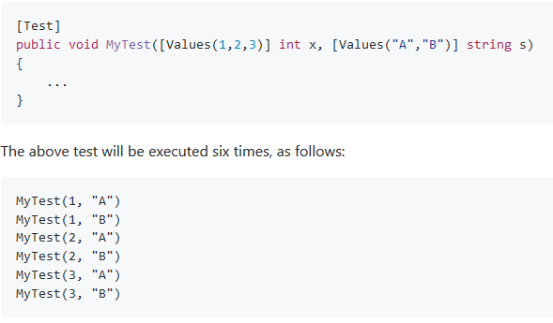
Nunit Attributes (3)
[Values]
[TestCaseData]
TestCaseSource + TestCaseData

Slide 11
Homework
Copy all your tests from the Tests class to the class named on you. Please, do not delete anything from the Tests class.
Try to improve the selectors of your tests
Optional homework: Choose at least 5 pages, and on each of them check all the Header links are present
Hint: use [TestCaseData] without ExpectedReuslt part. Pass the address of the page you are testing as String argument of the test.

Slide 12
Nunit Assertions (1)
Assertions are used to CHECK that what is going on meets what is expected (in a pretty way ☺) If assertion fails, Failure is reported for the current test, and further execution of the current test is terminated. Failure of a Test, does not impact other tests
Old style (Classic Model) https://github.com/nunit/docs/wiki/Classic-Model https://github.com/nunit/docs/wiki/String-Assert | New style (Constraint Model) https://github.com/nunit/docs/wiki/Constraint-Model
Assert.AreEqual(2+2,4); | Assert.That(2+2, Is.EqualTo(4));
StringAssert.Contains("BC", "ABCD"); | Assert.That("ABCD", Does.Contain("BC"));
StringAssert.EndsWith("BCD", "ABCD"); | Assert.That("ABCD", Does.EndWith("BCD"));
Assert.GreaterOrEqual(567, 100); | Assert.That(567, Is.GreaterThanOrEqualTo(100));
 | int[] array = new int[] { 1, 2, 3 }; Assert.That( array, Has.Exactly(1).EqualTo(3) ); Assert.That( array, Has.All.Positive );

Slide 13
Nunit Assertions (2)
Assert.Pass();
Assert.Fail();
Assert.Ignore();
Assert.Inconclusive();
Add failing message
Assert.AreEqual(2+2, 5, “Of course they are not equal”);
Assert.That(2+2, Is.EqualTo(4), “Of course they are not equal”);
Assert.Ignore(“We are not testing this on Monday”);

Slide 14
Nunit Assertions (3) Warnings
Warn.Unless(2+2 == 5);
Anything that you assert, you can warn (new syntax):
https://github.com/nunit/docs/wiki/Warnings:
“Sometimes - especially in integration testing - it's desirable to give a warning message but continue execution. Beginning with release 3.6, NUnit supports this with the Warn class”
Warn.If(2+2, Is.EqualTo(5));
Warn.If(2+2, Is.Not.EqualTo(4));
Warn.Unless(2+2 == 4);

Slide 15
WebDriver Url and Title
driver.Url
driver.Title

Slide 16
Homework
Add at least one Assert to each of your tests
Optional: One and the same test in different break points:
Create a test to check that Yavlena logo is present both on Desktop and Mobile view.
Hint: use TestCase attribute to pass the test as argument the window size. Use
driver.Manage().Window.Size = new System.Drawing.Size(300, 968);
to resize your window
Advanced Optional: Create a test to check element that is changing from Desktop to Mobile view
Create a test to click on the “Продажба” link in the header of the website. The test should be valid for both Desktop and Mobile view

Slide 17
Demo
Selenium SetUp and TearDown (moved to week 7)

Slide 18
Q & A

Slide 19
Sources:
1. https://github.com/nunit/docs

